Slide 1
Standard Template Library & The <algorithm> Header
INFO-3135

Slide 2
What Is The STL?
The Standard Template Library (STL) is a set of C++ template classes to provide common programming data structures and their functions
  Though due to being so generic, may not have an ideal implementation for your use-case
We can break the STL into four separate sections
  Containers (lists, stacks, arrays)
  Functions
  Iterators
  Algorithms
Notes:
https://www.geeksforgeeks.org/the-c-standard-template-library-stl/

Slide 3
Containers
Types of Containers:
  Sequence
  Sequence Adapters
  Associative
  Un-ordered Associative

Slide 4
Containers - Sequence
Types of Containers:
  Array
  Vector
  List
  Deque
Properties:
  Can access data in a sequential order
    Arrays and Vectors usually in contiguous memory, though not necessarily
    Lists and Deques Not usually not (in contiguous memory)

Slide 5
Containers - Sequence Adapters
Types of Containers:
  Queue
  Priority Queue
  Stack
Properties:
  Provides a different interface/access for a sequence container

Slide 6
Containers - Associative
Types of Containers:
  Set
  Map
  Multi-Set
  Multi-Map
Properties:
  Implement sorted data structures that can be quickly searched,
  often a red-black tree.
    O(log n) complexity (Binary Search)

Slide 7
Containers - Un-ordered Associative
Types of Containers:
  Unordered Set
  Unordered Map
  Unordered Multi-Set
  Unordered Multi-Map
Properties:
  Implement unsorted data structures that can be quickly searched
    Typically O(1)
    Can be as bad as O(n) is some cases
      Bad hash function causing collisions

Slide 8
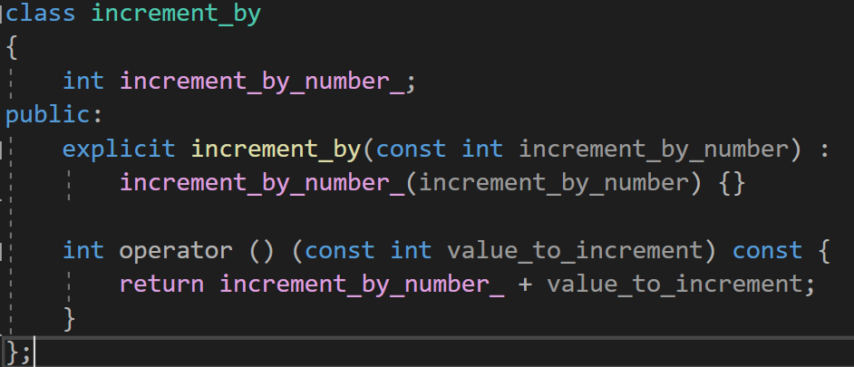
Predicate Functions / Functors
The STL includes classes that overload the function call operator.
Theses are also known as ‘Functors’
More on this when we get to algorithms

Slide 9
Iterators
  Iterators are used to point at the memory addresses of STL containers
  They tie containers with the algorithm library.
    Written to “look like” and somewhat behave like pointers - but aren’t at all
    Allow moving around & accessing data within a container
    “Iterate” means “repeat”
    May restrict operations that you may perform
      Such as pointer arithmetic (add, decrement)
    Can reduce complexity of a program
    Not intended to reduce execution time (not that they are “slow” though…)
  Iterators are NOT raw memory addresses (even though the look like pointers)
    You cannot call delete on an iterator, for instance

Slide 10
Algorithms
  The Standard Template Library (STL) provides algorithms that we commonly use no matter the underlying data structure
  These algorithms provide the following:
    Sorting
    Searching
    Data Transformation / Manipulation
  To gain access to all this power just add the <algorithm> header

Slide 11
Algorithms - Sorting
  std::sort(RandomAccessIterator start, RandomAccessIterator end)
  Will use the default < operator if it exist for the object.
    If it doesn’t the code will not compile
    You can always overload it yourself if required
  std::sort(RandomAccessIterator start, RandomAccessIterator end, Pred predicate_function)
    Like in the sorting lab
    Takes a comparison function matching the signature
      bool function_name(const T& lhs, const T& rhs)
        This returns if true if the elements are in correct order

Slide 12
Algorithms - Searching
  std::find(InputIterator start, InputIterator end, const T& value_to_search_for)
  Searches and returns an iterator to the first element that has equal value.
    T needs a == operator
  What if the value doesn’t exist?
    std::find still returns an iterator
      But it points to the end of the container (or one past the last element)
    We can test for this and program to handle this situation
Start
End

Slide 13
Algorithms - Data Transformation / Manipulation
  std::transform(InputIterator start, InputIterator end, OutputIterator out_begin, Function func)
    Allows us to perform a modification task on elements in our range
    This could be on some or all the elements
    The results can be stored back into the original container or stored in a new container.
      The result container must be the correct size for this to work
        If it is too small, it will throw an exception
  std::fill(InputIterator start, InputIterator end, OutputIterator out_begin, Function func)
    Populate our container will a common value

